Slide 1
Data Modeling
Learning Outcome :
Utilize Data modeling techniques in the SDLC approach

Slide 2
LEARNING OBJECTIVES
You should be able to understand …
Keys
Primary Key
Unique Key
Artificial Key
Foreign Key
Mapping ERDs into Relational Schema
Mapping E-R Diagrams to Relational Schema
Relational Schema Notation
Rules for Mapping E-R Diagrams

Slide 3
Primary Key:
Unique
e.g: FirstName & LastName cannot be always unique
Always available
e.g: Visa residence numbers is not available for all
Stable
e.g: Phone number is not stable
Simple and easy to remember
Maximum two columns
Never Null

Slide 4
Unique Key
A unique column that can not be a primary key because it can be null for some instances
Example: Passport numbers in one country are unique but some people do not have passports yet!

Slide 5
Artificial Key
It is a meaningless primary key introduced by the database designer to identify each row.
It is usually an Integer
Recommended to use it when:
There are many foreign keys
Natural key contains a null value
Natural key is not unique
Natural key is large and complex

Slide 6
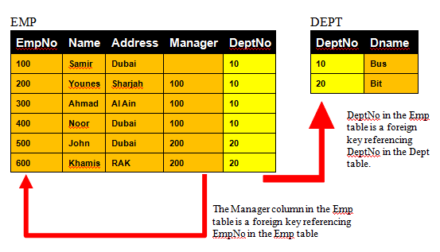
Foreign Key It is an attribute that is referencing a primary key in another relation

Slide 7
Hands-on Exercise 1
Think of Primary, Unique, Artificial, or Foreign keys that can exist inside each of the following Tables in a Database:
Employees Table that stores info about employees in a company
Cars Table that stores info about company cars
Sales Table that stores the relationship between Customers and Purchased Items
Addresses Table that stores info about student addresses
.

Slide 8
Hands-on Exercise 1

Slide 9
Mapping ERDs into Relational Schema

Slide 10
Mapping E-R Diagrams to Relational Schema
Logical database design is about mapping the E-R Model to relational tables to produce an initial design.
First, entities are mapped to simple tables.
Second, attributes are mapped to columns.
Third, unique identifiers are mapped to primary keys.
Finally, relationships are mapped to foreign keys.
The final product should be a relational “schema”, which will act as a template for the actual tables that will make up the database.
CUSTOMER (Cust-ID, Cust-Name, Address, City, Phone)
ORDER (Order-No, Date, Cust-ID*)
ORDER_LINE (Order-No*, Prod-ID*, Quantity)
PRODUCT (Prod-ID, Description, Unit-Price)
ORDER_LINE
PRODUCT
CUSTOMER
ORDER

Slide 11
Relational Schema Notation
The following conventions are commonly used when representing a relational schema:
Table name in capital letters
Column names separated by commas and enclosed in brackets
Primary key underlined
Foreign key(s) denoted by an asterisk(*)
CUSTOMER (Cust-ID, Cust-Name, Address, City, Phone)
ORDER (Order-No, Date, Cust-ID*)
ORDER_LINE (Order-No*, Prod-ID*, Quantity)
PRODUCT (Prod-ID, Description, Unit-Price)
CUSTOMER (Cust-ID, Cust-Name, Address, City, Phone)
ORDER (Order-No, Date, Cust-ID*)
ORDER_LINE (Order-No*, Prod-ID*, Quantity)
PRODUCT (Prod-ID, Description, Unit Price)
CUSTOMER (Cust-ID, Cust-Name, Address, City, Phone)
ORDER (Order-No, Date, Cust-ID*)
ORDER_LINE (Order-No*, Prod-ID*, Quantity)
PRODUCT (Prod-ID, Description, Unit-Price)

Slide 12
Rules for Mapping E-R Diagrams
Mapping Regular Entities
Regular entities can be directly converted into tables.
Each attribute of the entity becomes a column in the corresponding table.
The primary key of the entity becomes the primary key of the table.
Project
# Project No Project Manager Starting Date Ending Date
Project_No | Project_Manager | Start Date | End Date
P1 | Salim Asmar | 1-Dec-01 | 9-Jan-02
P2 | Ahmed Nasim | 2-Jan-05 | 1-Nov-06
P3 | Riyad Omar | 3-Feb-01 | 4-Mar-01
P4 | Ahmed Nasser | 1-Dec-02 | 9-Jan-03
PROJECT (project_no, project_manager, starting_date, ending_date)

Slide 13
Hands-on Exercise 2
Map the following ERD into a Relational Schema, showing the table names, the table attributes, and the primary key:
Student
Student_No
Student_Name
Student_DOB
Student_Address
.

Slide 14
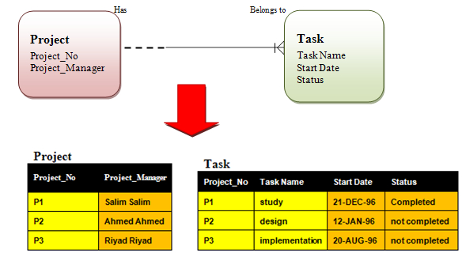
2. Mapping Dependent (Weak) Entities
Dependent entities become dependent tables.
The primary key of the new table is a combination of the primary key of the parent table and the primary key of the new table.
The foreign key refers to the parent table.
The foreign key must be not null.
PROJECT(Project_no, Project_manager)
TASK (Project_no*, Task_name, Start_Date, Status)

Slide 15
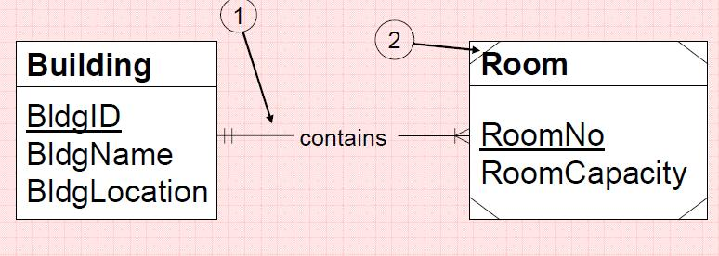
Hands-on Exercise 3
Map the following ERD into a Relational Schema, showing the table names, the table attributes, and the primary and foreign keys:
.

Slide 16
3. Mapping Binary Relationships
After converting all of the entities into tables, the database designer must now focus on the various relationships between entities.
Since binary relationships (ie, relationships between 2 entities) are the most common types of relationship encountered in data modeling, these are usually converted first.
The procedure used to convert relationships depends on the maximum and minimum cardinality of the relationship.
For binary relationships, there are six cases to consider:
Maximum Minimum
Cardinality Cardinality
a)
b)
c)
d)
e)
f)
1:1 Both sides mandatory
1:1 Either side optional
1:1 Both sides optional
1:M M side mandatory
1:M M side optional
M:N n/a

Slide 17
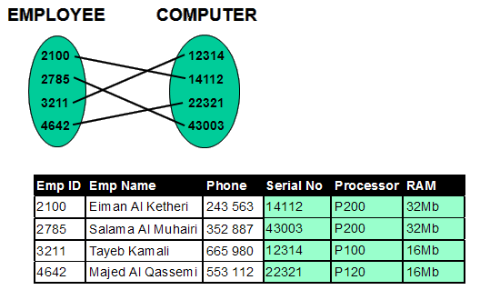
3a) 1:1 Both sides mandatory
Merge the two entities into a single table.
Choose one of the original primary keys as the primary key for the table.
EMPLOYEE (Emp-ID, Emp-Name, Phone, Serial-No, Processor, RAM)

Slide 18
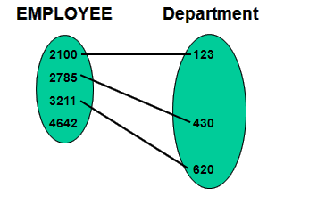
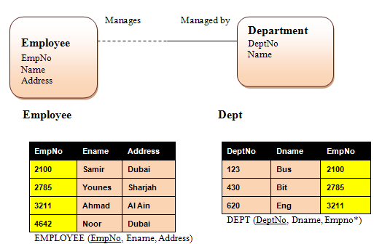

3b) 1:1 One Side Optional, Other side Mandatory
In One-to-One relationship with a mandatory participation in one direction, the primary key of the optional side table will be the foreign key in the table at the mandatory end.

Slide 19
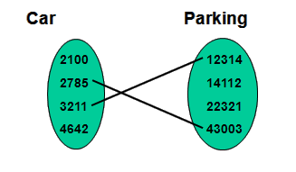
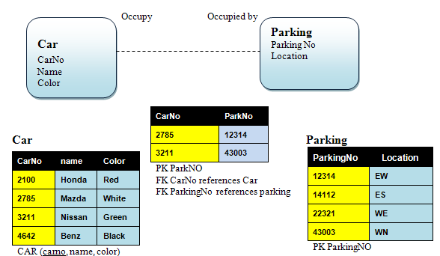
3c) 1:1 Both sides optional
Place the primary keys from the two entities into a new table.
Choose one of the columns as the primary key for the new table

Slide 20
Hands-on Exercise 4
Draw the ERD for each of the following case requirements and then map the ERDs into a Relational Schema, showing the table names, the table attributes, and the primary and foreign keys:
CASE 1:
Each Student must have only one laptop and each laptop must belong to only one student

Slide 21
Hands-on Exercise 4
CASE 2:
Each Student may have only one laptop and each laptop must belong to only one student
CASE 3:
Each Student may have only one laptop and each laptop may belong to only one student

Slide 22
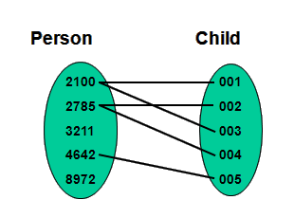
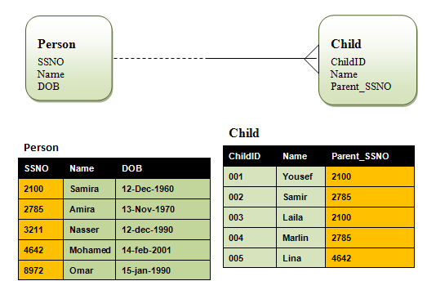
3d) 1:M M side mandatory
Create a foreign key in the table representing the “child” entity (the M side) that references the primary key in the table representing the “parent” entity (the 1 side).
The foreign key status is Not Null if the participation of the many side entity is mandatory

Slide 23
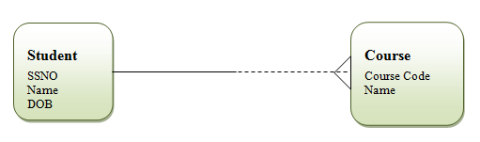
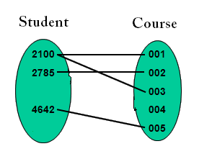
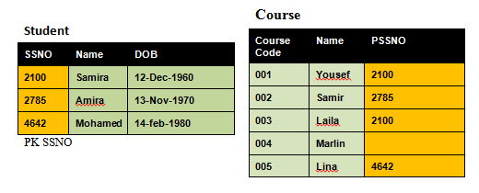
3e) 1:M M side optional
Create a foreign key in the table representing the “child” entity (the M side) that references the primary key in the table representing the “parent” entity (the 1 side).
The foreign key status is Null if the participation of the many side entity is optional

Slide 24

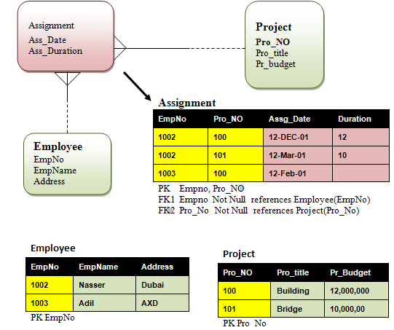
3f) M:N
Place the primary keys from the two entities into a new table.
Choose this two-key composite to be the primary key for the new table.
Include any relationship attributes, if present.

Slide 25
Hands-on Exercise 5
Draw the ERD for each of the following case requirements and then map the ERDs into a Relational Schema, showing the table names, the table attributes, and the primary and foreign keys (State whether FK can have null values or not):
CASE 1:
Each Student can have many laptops and each laptop must belong to one student

Slide 26
Hands-on Exercise 5
CASE 2:
Each Student can have many laptops and each laptop may belong to one student
CASE 3:
Each Student can take many courses and each course may have many student

